Slide 1



Blockchain-Based Distributed Security Policy Execution and Audit Trails：Ensuring Immutable Policy Compliance
Houye Dong

Slide 2
Research questions
What are the key components of a blockchain-based policy execution and audit trail system
across multiple tenants in the cloud?
In multi-tenant cloud environments, ensuring secure and transparent policy execution and audit trails is crucial. Blockchain technology offers a decentralized and immutable ledger, enhancing data integrity and trust among tenants.
By integrating blockchain, each policy execution can be recorded as a tamper-proof transaction, providing a clear and auditable history of actions taken within the system.
This approach addresses challenges, which are common in traditional centralized systems. Implementing blockchain-based solutions can lead to reduced administrative overhead, and increased confidence among stakeholders in the multi-tenant cloud infrastructure.
novelty/general(all cloud included)
tenants
Notes:
This approach addresses challenges such as unauthorized access, data tampering, and lack of transparency, which are common in traditional centralized systems. Implementing blockchain-based solutions can lead to improved compliance, reduced administrative overhead, and increased confidence among stakeholders in the multi-tenant cloud infrastructure.

Slide 3
Background & Problem Statement
1. Challenges in Distributed Cloud Environments
Decentralized, multi - tenant structures hamper uniform security policy implementation and execution tracking.
Lack of central control causes issues in compliance, transparency, and accountability across multiple cloud providers.
2. Limitations of Traditional Approaches
Rely on centralized logging, third - party oversight, or manual audits, with risks like tampering, inefficiency, and no real - time enforcement. Hard to ensure policy execution integrity and auditability in multi - cloud setups.
3. Blockchain as a Potential Solution
Offers a decentralized, immutable ledger, strengthening security policy enforcement and auditability.
Smart contracts automate policy execution, and blockchain - based logging ensures transparent audit trails.
simplify
Notes:
1. Challenges in Distributed Cloud Environments
Modern cloud environments operate in a decentralized and multi-tenant structure, making it difficult to enforce security policies consistently and track their execution. The absence of centralized control leads to challenges in policy compliance, transparency, and accountability across multiple cloud providers.
2. Limitations of Traditional Approaches
Existing security policy enforcement mechanisms rely on centralized logging, third-party oversight, or manual audits, which introduce risks such as tampering, inefficiencies, and lack of real-time enforcement. Traditional methods struggle to ensure both policy execution integrity and verifiable auditability in multi-cloud environments.
3. Blockchain as a Potential Solution
Blockchain technology provides a decentralized and immutable ledger that can enhance both security policy enforcement and auditability. Smart contracts enable automated policy execution, ensuring security rules are consistently applied, while blockchain-based logging ensures transparent and verifiable audit trails.
4. Research Gaps
While blockchain has been studied for access control and general auditing, its potential for real-time security policy enforcement and auditable tracking in multi-tenant cloud environments remains underexplored. Key challenges include ensuring execution integrity, balancing performance and scalability, and enabling seamless cross-cloud verification.
5. Research Goal
This research aims to investigate how blockchain can be leveraged to enhance both the enforcement and auditability of security policies in distributed cloud infrastructures. The study will explore the architectural components of a blockchain-based system that ensures policy compliance, execution integrity, and transparent auditing while addressing challenges related to performance, scalability, and adaptability.
1. Challenges in Distributed Cloud Environments
Decentralized, multi - tenant structures hamper uniform security policy implementation and execution tracking.
Lack of central control causes issues in compliance, transparency, and accountability across multiple cloud providers.
2. Limitations of Traditional Approaches
Rely on centralized logging, third - party oversight, or manual audits, with risks like tampering, inefficiency, and no real - time enforcement. Hard to ensure policy execution integrity and auditability in multi - cloud setups.
3. Blockchain as a Potential Solution
Offers a decentralized, immutable ledger, strengthening security policy enforcement and auditability.
Smart contracts automate policy execution, and blockchain - based logging ensures transparent audit trails.
4. Research Gaps
Blockchain's potential for real - time security policy enforcement and auditable tracking in multi - tenant clouds is underexplored.
Key challenges: execution integrity, performance - scalability balance, and cross - cloud verification.
5. Research Goal
Explore using blockchain to boost security policy enforcement and auditability in distributed cloud infrastructures.
Examine blockchain - based system components for policy compliance, execution integrity, and transparency, while addressing performance, scalability, and adaptability.

Slide 4
Problem Statement
4. Research Gaps
Blockchain's potential for real - time security policy enforcement and auditable tracking in multi - tenant clouds is underexplored.
Key challenges: execution integrity, performance - scalability balance, and cross - cloud verification.
5. Research Goal
Explore using blockchain to boost security policy enforcement and auditability in distributed cloud infrastructures.
Examine blockchain - based system components for policy compliance, execution integrity, and transparency, while addressing performance, scalability, and adaptability.
Chapter1 2 final evaluation
Notes:
1. Challenges in Distributed Cloud Environments
Modern cloud environments operate in a decentralized and multi-tenant structure, making it difficult to enforce security policies consistently and track their execution. The absence of centralized control leads to challenges in policy compliance, transparency, and accountability across multiple cloud providers.
2. Limitations of Traditional Approaches
Existing security policy enforcement mechanisms rely on centralized logging, third-party oversight, or manual audits, which introduce risks such as tampering, inefficiencies, and lack of real-time enforcement. Traditional methods struggle to ensure both policy execution integrity and verifiable auditability in multi-cloud environments.
3. Blockchain as a Potential Solution
Blockchain technology provides a decentralized and immutable ledger that can enhance both security policy enforcement and auditability. Smart contracts enable automated policy execution, ensuring security rules are consistently applied, while blockchain-based logging ensures transparent and verifiable audit trails.
4. Research Gaps
While blockchain has been studied for access control and general auditing, its potential for real-time security policy enforcement and auditable tracking in multi-tenant cloud environments remains underexplored. Key challenges include ensuring execution integrity, balancing performance and scalability, and enabling seamless cross-cloud verification.
5. Research Goal
This research aims to investigate how blockchain can be leveraged to enhance both the enforcement and auditability of security policies in distributed cloud infrastructures. The study will explore the architectural components of a blockchain-based system that ensures policy compliance, execution integrity, and transparent auditing while addressing challenges related to performance, scalability, and adaptability.
1. Challenges in Distributed Cloud Environments
Decentralized, multi - tenant structures hamper uniform security policy implementation and execution tracking.
Lack of central control causes issues in compliance, transparency, and accountability across multiple cloud providers.
2. Limitations of Traditional Approaches
Rely on centralized logging, third - party oversight, or manual audits, with risks like tampering, inefficiency, and no real - time enforcement. Hard to ensure policy execution integrity and auditability in multi - cloud setups.
3. Blockchain as a Potential Solution
Offers a decentralized, immutable ledger, strengthening security policy enforcement and auditability.
Smart contracts automate policy execution, and blockchain - based logging ensures transparent audit trails.
4. Research Gaps
Blockchain's potential for real - time security policy enforcement and auditable tracking in multi - tenant clouds is underexplored.
Key challenges: execution integrity, performance - scalability balance, and cross - cloud verification.
5. Research Goal
Explore using blockchain to boost security policy enforcement and auditability in distributed cloud infrastructures.
Examine blockchain - based system components for policy compliance, execution integrity, and transparency, while addressing performance, scalability, and adaptability.

Slide 5
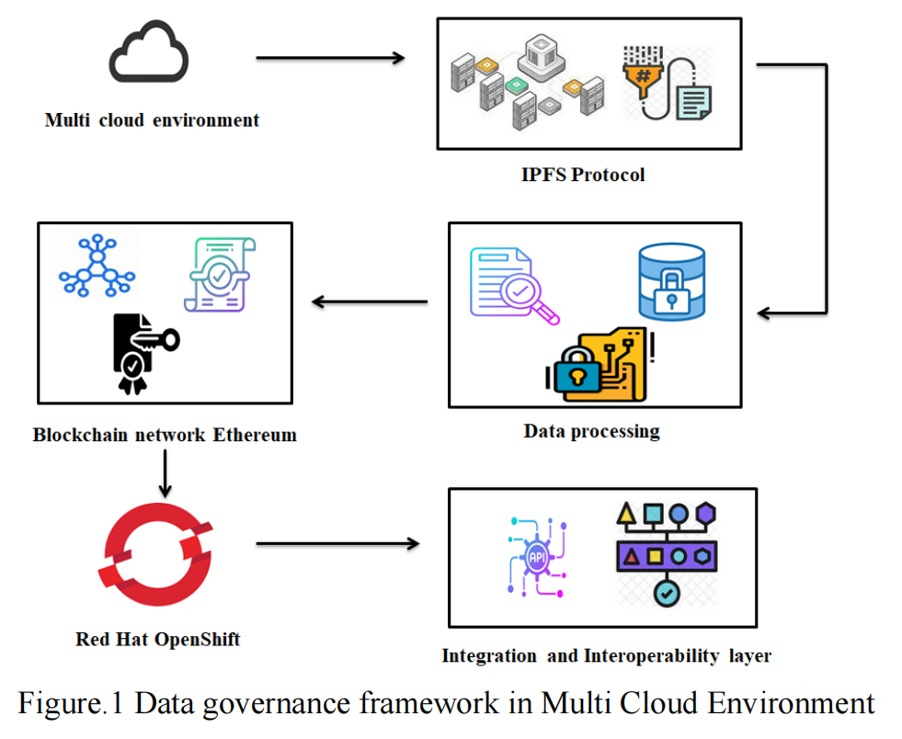
Related Work
Sanjay Kanth Balachandar, et al. 2024
Blockchain-enabled Data Governance Framework for Enhancing Security and Efficiency in Multi-Cloud Environments through Ethereum, IPFS, and Cloud Infrastructure Integration.
This paper proposes an innovative blockchain - based data governance framework, integrating Ethereum, IPFS, and cloud infrastructure to boost data security and efficiency in multi - cloud setups.
Setup: Builds an experimental environment with OpenStack, Red Hat OpenShift, IPFS, and Ethereum for performance testing.
Verification: Checks various performance aspects. IPFS ensures data reliability and efficient storage. Different components in the framework show good performance in throughput, latency, and resource utilization. The system manages resources well during data transfer.
Advantages: Ethereum's PoA mechanism processes data efficiently. IPFS optimizes storage and retrieval. OpenStack uses resources effectively. The framework can handle data well, meet real - time access needs, and utilize resources rationally.

Slide 6
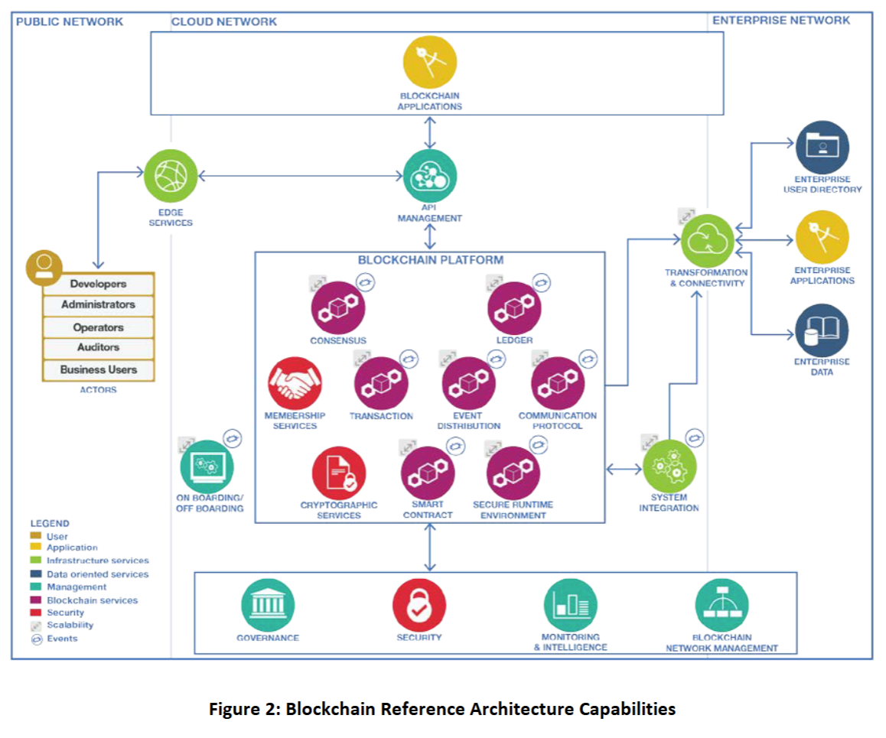
Related Work
Cloud Standards Customer Council, a program launched by the OMG to advance the adoption of cloud computing
Cloud Customer Architecture for Blockchain
This paper is centered around blockchain applications and its cloud deployment considerations. In finance, it streamlines letter of credit operations with shared ledgers and smart contracts. In the supply chain, it tracks assets precisely, enhancing transparency. In healthcare, it simplifies payment - related data management. It also plays roles in IoT transactions, contract management, and food safety traceability.
When deploying blockchain in the cloud, several factors need attention. Scalability and elasticity are crucial. Data sovereignty is a major concern due to varying regulations on data storage locations. Resilience and security are essential. Hybrid cloud models can balance data security and software management needs.

Slide 7
Related Work
PRABAL BANERJEE, et al. 2024
Cumulus: Blockchain-Enabled Privacy Preserving Data Audit in Cloud
Cloud computing enables users to store data on cloud servers, but the integrity of data may be at risk due to potential server tampering. Existing Proof of Retrievability (PoR) schemes have trust - related limitations.
This paper presents Cumulus, a blockchain - based protocol. It utilizes blockchain smart contracts for dispute settlement and payment, and state channels to improve efficiency. Cumulus aims to achieve authenticity, extractability, privacy, and fairness.
Its security is proven in the UC framework. A prototype implementation on modified Ethereum demonstrates that the protocol has comparable performance and incurs minimal overhead, outperforming previous solutions.

Slide 8
Related Work
Mueen Uddin, et al. 2024
Review: Next-Generation Blockchain-Enabled Virtualized Cloud Security Solutions: Review and Open Challenges
Blockchain as Technology Solution
Blockchain is an open - distributed ledger with features like immutability, decentralization, transparency, and security. It offers services such as distributed ledgers, consensus mechanisms (PoW, PoS), smart contracts, and cryptography. Different blockchain platforms, like Bitcoin, Ethereum, and Hyperledger Fabric, have distinct uses. Bitcoin is for digital currency, Ethereum uses smart contracts for transactions, and Hyperledger Fabric serves enterprises.
Blockchain-Enabled Virtualized Cloud Security Solutions
Blockchain can solve numerous issues in virtualized cloud environments. Smart contracts are vital in managing cloud services, making cloud operations more secure and efficient.
in terms of data integrity and privacy (5.3), blockchain - enabled smart contracts ensure the privacy of users and services by customizing access rules, conditions, and time. They control who has the right to update, upgrade, patch data and services.
In terms of authentication and authorization (5.4), blockchain smart contracts are created and executed by peer nodes. They are used to implement decentralized authentication and authorization rule logic, providing single - party and multi - party authentication for all cloud devices and users on the cloud computing platform, and offering improved authorization access rules.
Notes:
3. Blockchain-Enabled Cloud Security Related Work
Research on cloud security and blockchain is limited. Most work focuses on using blockchain to enhance cloud computing security. For example, Zhao proposed a differentially private data sharing model, Sharma suggested a cryptocurrency - enabled blockchain solution, and Ali et al. put forward a secure data provenance model. Others introduced mechanisms for handling cloud - related scenarios like collaborative governance and mobile intercloud systems. These studies show the potential of blockchain in improving cloud security, such as better data control and privacy protection.
4. Blockchain as Technology Solution
Blockchain is an open, distributed ledger technology. Its key characteristics include immutability, decentralization, transparency, and security. It provides services like distributed shared ledgers, consensus mechanisms (e.g., PoW, PoS), smart contracts, and cryptography. There are different types of blockchain platforms, such as Bitcoin, Ethereum, and Hyperledger Fabric, each with its own features. For instance, Bitcoin is for digital currency transactions, Ethereum uses smart contracts for transaction storage, and Hyperledger Fabric is a private, permissioned blockchain for enterprise use.
5. Blockchain-Enabled Virtualized Cloud Security Solutions
Blockchain can address many problems in virtualized cloud infrastructures. It can be used for virtualized task scheduling, improving the efficiency of server machines. Blockchain - enabled data algorithms ensure anonymity and security. It also guarantees data integrity and privacy, authenticates and authorizes users, and enhances system resilience and fault tolerance. For example, smart contracts play a crucial role in managing cloud services and devices, making cloud transactions more secure and reliable. 这篇论文在多个部分提及了智能合约：
区块链服务部分（4.2.3）：该部分指出智能合约和链码为云用户提供更好的服务和应用。一旦在区块链网络上创建并加载智能合约，它们会依据内置的业务逻辑独立执行任务，有助于在现有云系统中建立信任。此外，智能合约还提供安全服务，尤其是与用户认证、数据共享和存储的细粒度访问控制相关的服务。
区块链赋能的虚拟化云安全解决方案部分（5）：在这部分内容中，多次阐述了智能合约在云安全方面的作用。例如在数据完整性和隐私方面（5.3），区块链支持的智能合约通过自定义访问规则、条件和时间，确保用户和服务的隐私，控制谁有权更新、升级、修补数据和服务等；在认证和授权方面（5.4），区块链智能合约由对等节点创建和执行，用于实现去中心化的认证和授权规则逻辑，为云计算平台上的所有云设备和用户提供单方和多方认证，并提供改进的授权访问规则。 区块链解决方案并非主要是智能合约，智能合约只是其中一个重要组成部分。区块链解决方案包含多方面内容：
分布式共享账本：区块链技术提供分布式共享账本，所有参与方都能查看和记录交易，保证数据透明和不可篡改，这为云服务中的数据存储和交互提供可靠基础，独立于智能合约发挥作用。在云数据存储场景中，数据的存储记录可在账本上公开透明地呈现。
共识机制：如工作量证明（PoW）和权益证明（PoS）等共识算法，用于节点间达成一致，验证和确认交易，保障区块链网络的稳定运行。在没有智能合约参与的简单区块链交易场景中，共识机制确保交易被正确记录。
加密技术：运用椭圆曲线密码学（ECC）和哈希算法，如 SHA - 256，保障数据的完整性和真实性，防止数据被篡改和窃取，这是区块链安全的基石，与智能合约相互配合但又有独立功能。
智能合约：能自动执行预设条件的合约，在云安全方面，可用于用户认证、数据访问控制和服务管理等，提升云服务的安全性和自动化程度。

Slide 9
Related Work
Mueen Uddin, et al. 2024
Review: Next-Generation Blockchain-Enabled Virtualized Cloud Security Solutions: Review and Open Challenges
Once smart contracts are created and loaded onto the blockchain network, they execute tasks independently based on their built - in business logic, which helps to build trust in existing cloud systems. In addition, smart contracts also provide security services, especially those related to user authentication and fine - grained access control for data sharing and storage.

Slide 10
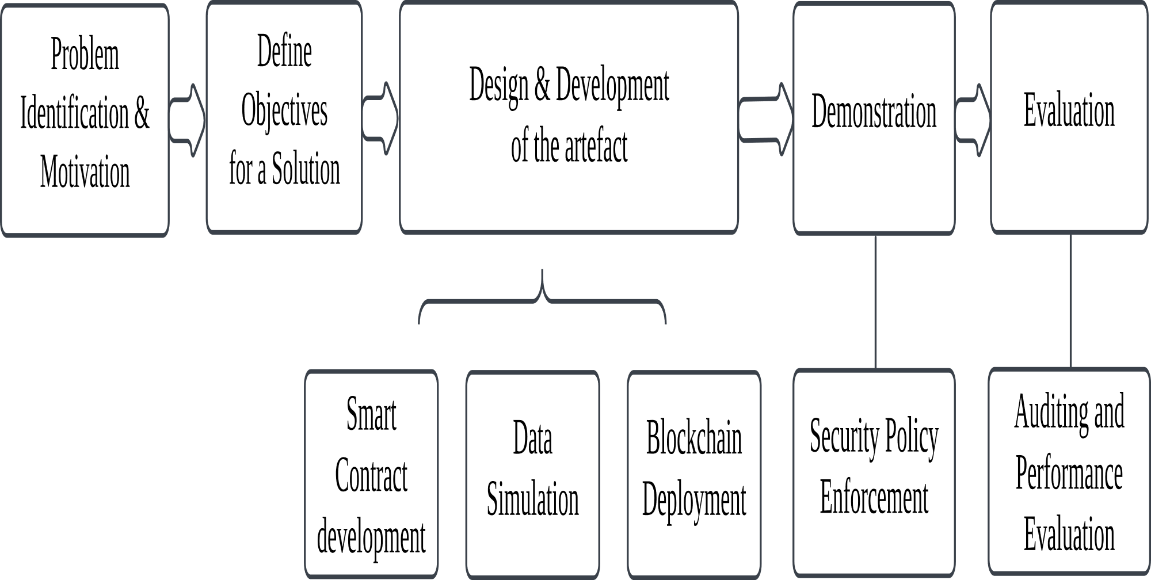
Methodology
Design Science Research (DSR)

Slide 11
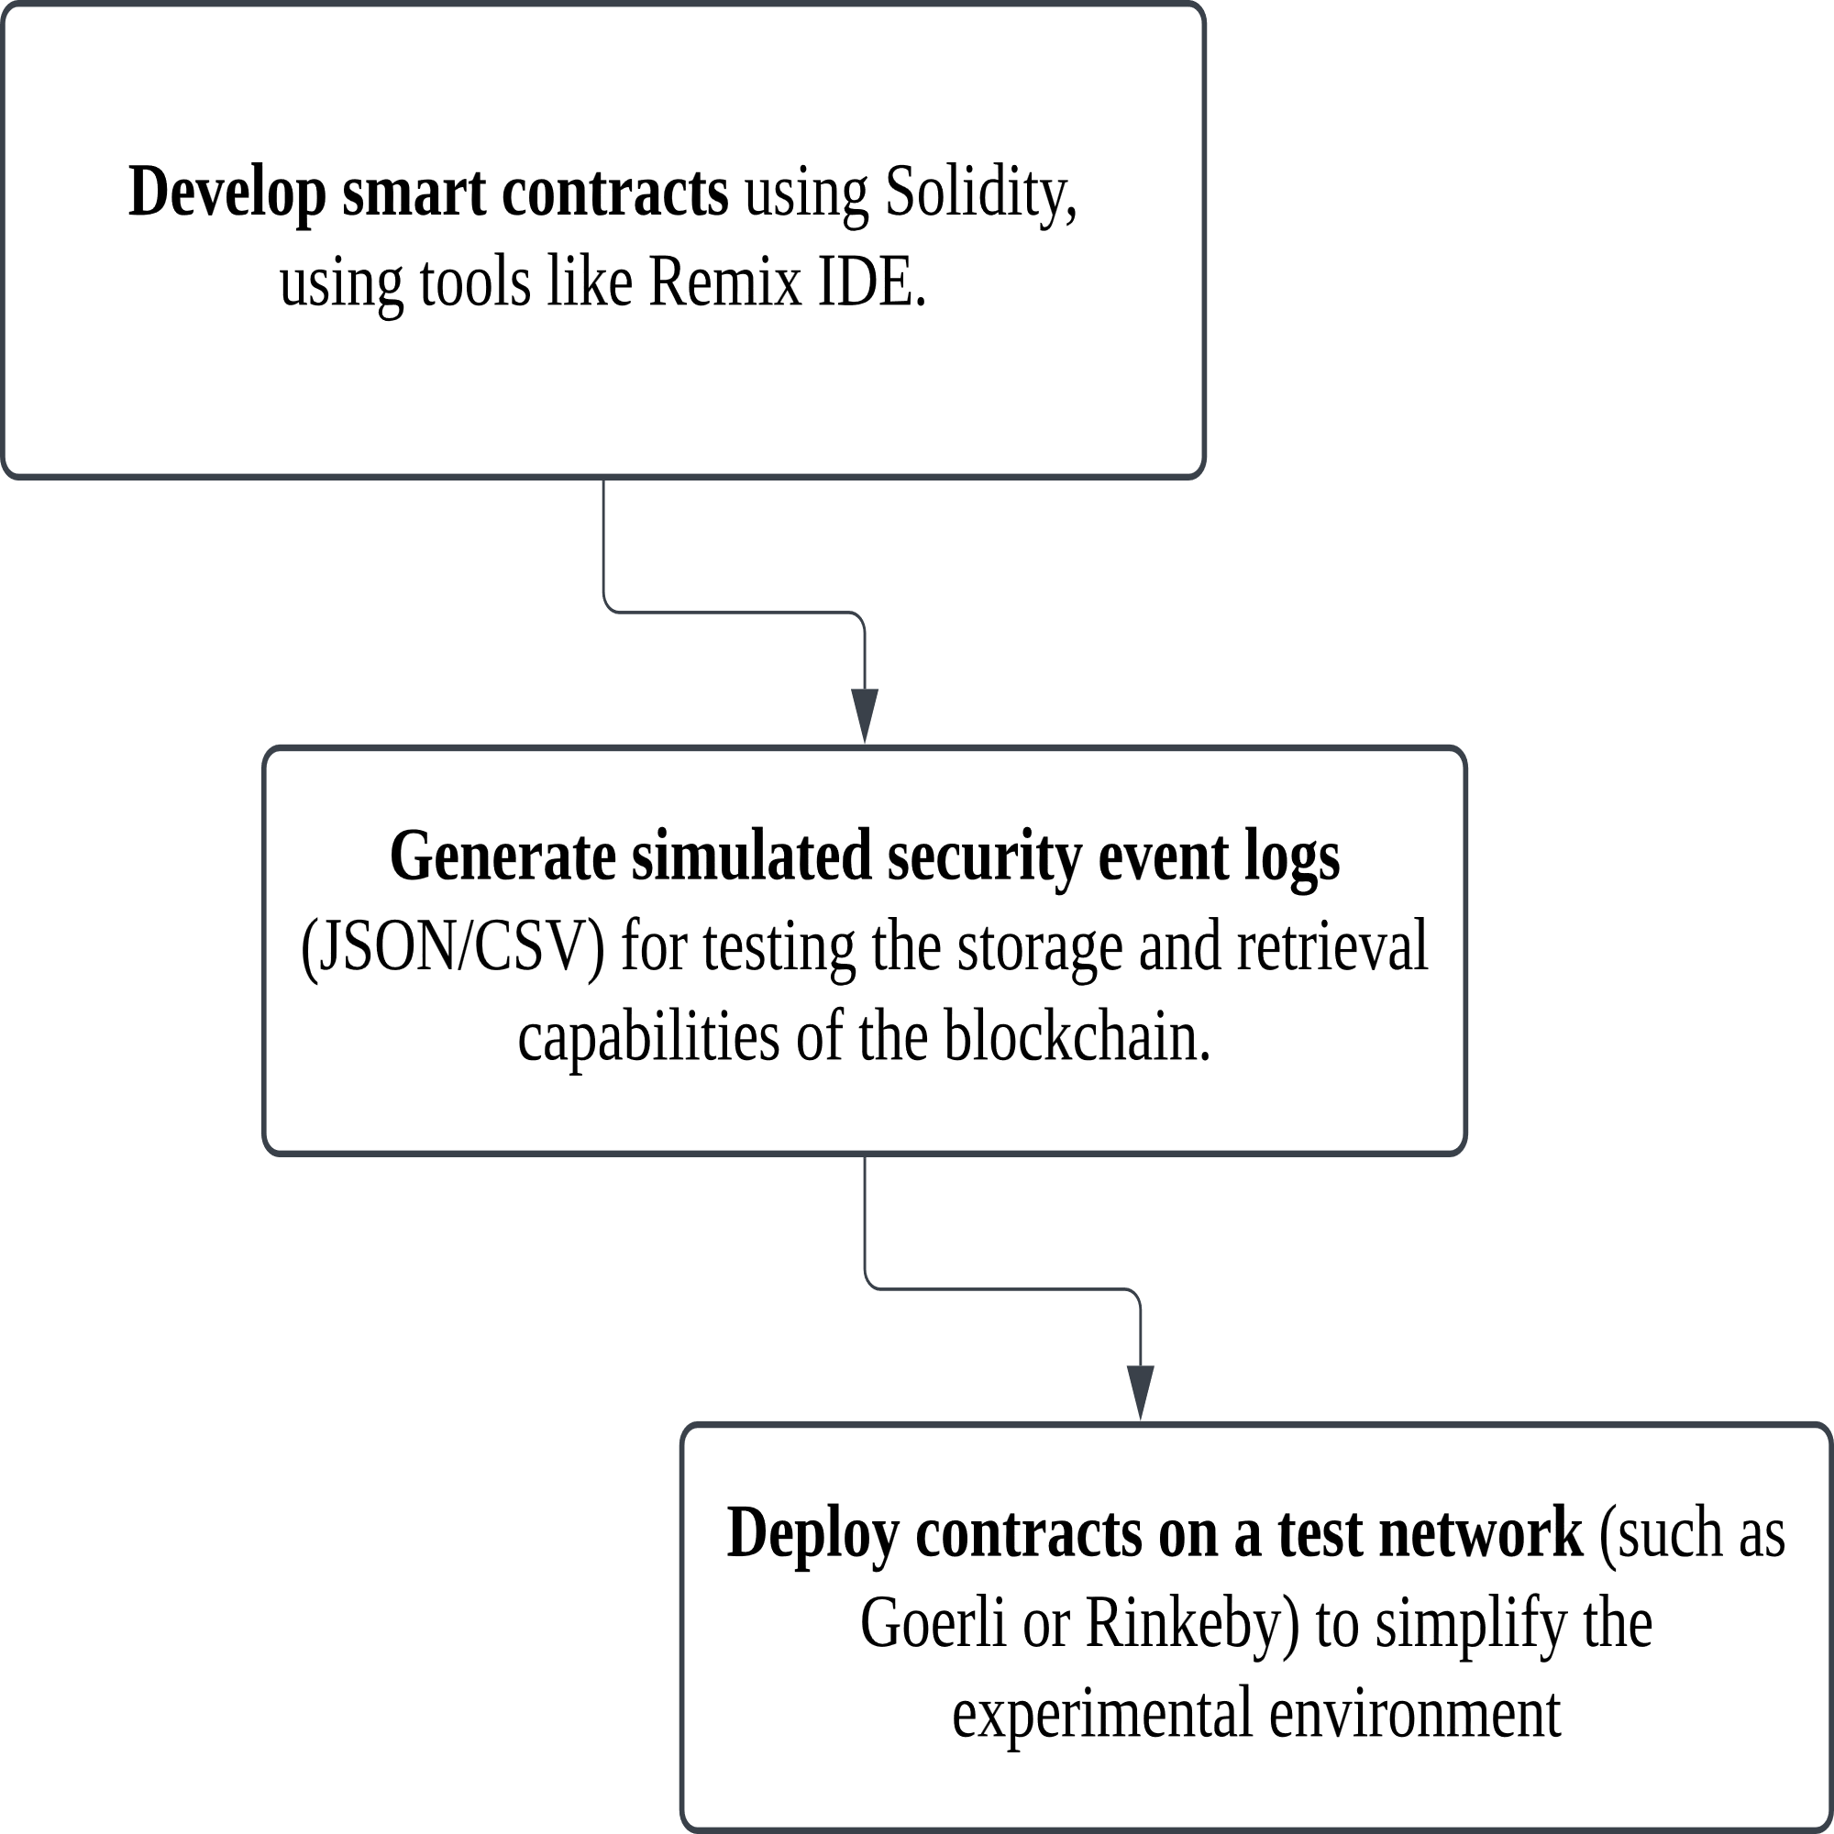
Methodology
Tenant Isolation Mechanisms
- Tenant Identification, Access Control, Log Isolation....
Company(eg. 4 categpries, Ericsson using google, medium company using another like..., small companies, employees and signle users)
Design and Development of the artefact

Slide 12
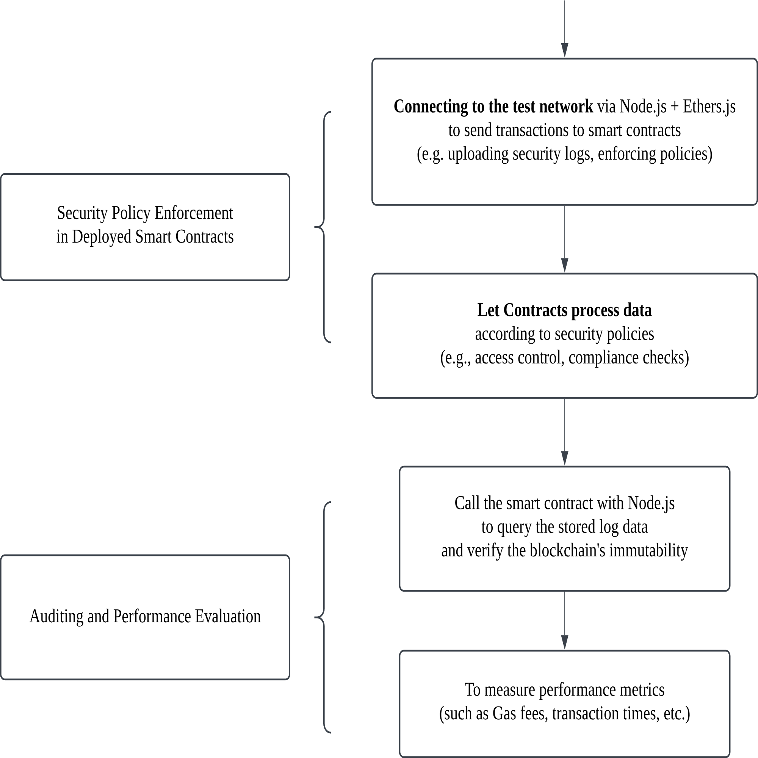
Methodology
Demostration and Evaluation
indicators:
privacy, information/
network security

Slide 13
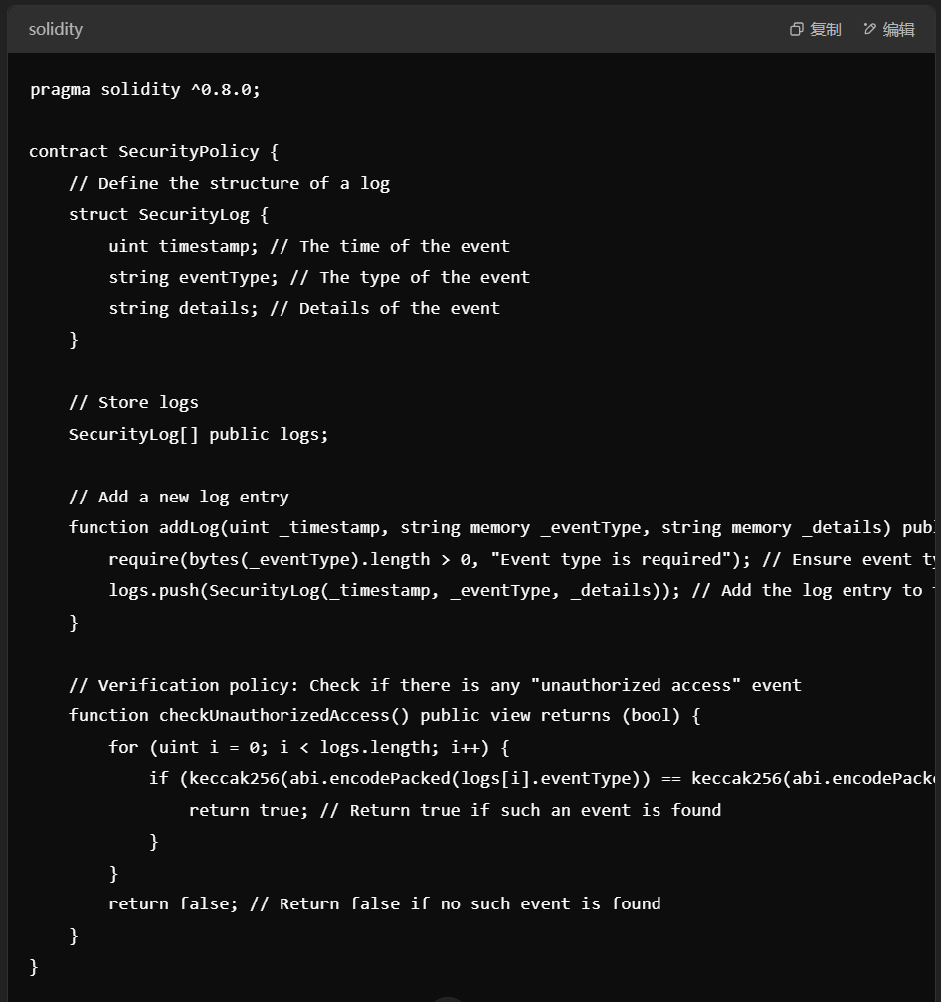
Example of a Simplified Smart Contract

Slide 14
Work Plan and Timeline
February
Finish the draft of first 3 chapters (Introduction, Related Works, Methodology)
March&April
Development and test of the Smart Contract
Revision and optimisation of the first three chapters
April&May
Writing Demostration and Evaluation Part (May 15)
June
Thesis Writing, Revision, Submission (June 20)

Slide 15
Thank you for listening

